Slide 1


Scaling Back-Propagation by
Parallel Scan Algorithm
Shang Wang^{1,2}, Yifan Bai¹, Gennady Pekhimenko^{1,2}
¹
²

Slide 2
Executive Summary
The back-propagation (BP) algorithm is popularly used in training deep learning (DL) models and implemented in many DL frameworks (e.g., PyTorch and TensorFlow).
Problem: BP imposes a strong sequential dependency along layers during the gradient computations.
Key idea: We propose scaling BP by Parallel Scan Algorithm (BPPSA):
Reformulate BP into a scan operation.
Scaled by a customized parallel algorithm.
1
2
3
4
5
6
7
8
Key Results: Θ(log n) vs. Θ(n) steps on parallel systems.
Up to 108× backward pass speedup (→ 2.17× overall speedup).
0
1
3
6
10
15
21
28

Slide 3
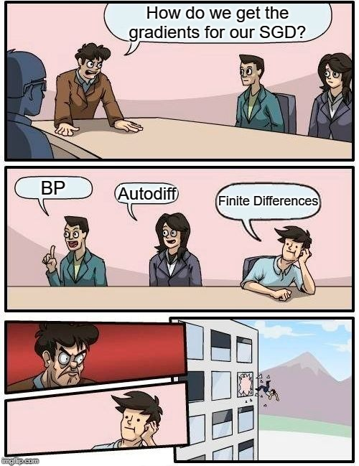







Back-propagation¹ (BP) Everywhere
¹Rumelhart et al. “Learning representations by back-propagating errors.”, Nature (1986)

Slide 4

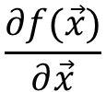





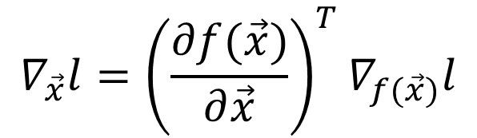
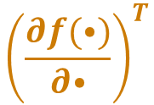

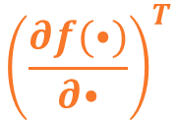
BP’s Strong Sequential Dependency
$$\vec{x}$$
Linear
ReLU
Linear
Loss
$$\vec{x}$$
$$l$$
$$∇ l$$
$${\left(\frac{∂f(⦁)}{∂⦁}\right)}^{T}$$
$$∇l$$
$${\left(\frac{∂f(⦁)}{∂⦁}\right)}^{T}$$
$$∇l$$
$$\frac{∂f(\vec{x})}{∂\vec{x}}$$
$$f\left(\vec{x}\right)$$
Jacobian
$$∇_{\vec{x}}l={\left(\frac{∂f(\vec{x})}{∂\vec{x}}\right)}^{T}∇_{f(\vec{x})}l$$
Strong Sequential Dependency along layers.

Slide 5
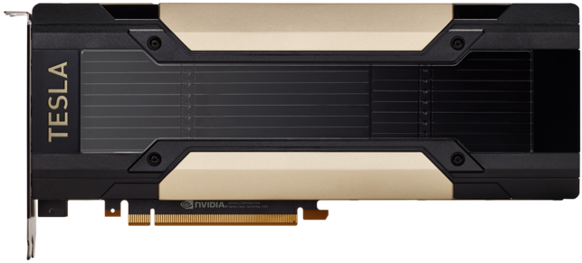











Data Parallel Training
Strong Sequential Dependency
$\vec{x}$₁
$l$₁
Respects BP’s strong sequential dependency.
Strong Sequential Dependency
$\vec{x}$₂
$l$₂
Conceptually simple, widely used.
Strong Sequential Dependency
$\vec{x}$₃
$l$₃
Effectively increases the batch size:
Generalization gap¹
Batch size scaling limit²
$\vec{x}$₄
$l$₄
Constraint: The model must fit in one device.
$\vec{x}$_{i}
$l$_{i}
¹Keskar, Nitish Shirish et al. “On Large-Batch Training for Deep Learning: Generalization Gap and Sharp Minima.” ICLR (2017)
²Shallue, Christopher J. et al. “Measuring the Effects of Data Parallelism on Neural Network Training.” Journal of Machine Learning Research 20 (2019)

Slide 6
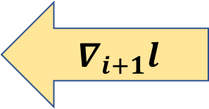
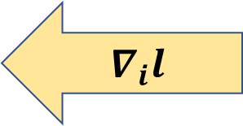
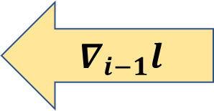
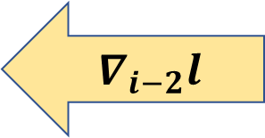
Model Parallel Training
Used when the model cannot fit in one device.
BP’s strong sequential dependency limits scalability.
Prior works on pipeline parallel training^{1,2} to mitigate such problem, but have their own limitations:
Linear per-device space complexity.
Trade-off between “bubble of idleness” vs. potential convergence affect.
$$∇_{i−2}l$$
Conv
$$∇_{i−1}l$$
Conv
$$∇_{i}l$$
Linear
$$∇_{i+1}l$$
¹Harlap, Aaron et al. “PipeDream: Fast and Efficient Pipeline Parallel DNN Training.” SOSP (2019)
²Huang, Yanping et al. “GPipe: Efficient Training of Giant Neural Networks using Pipeline Parallelism.” NeurIPS (2019)

Slide 7


Rethinking BP from an Algorithm Perspective
Prior Works
Problems with strong sequential dependency were studied in the past (80’), but in a much simpler context.
BP
We propose scaling Back-Propagation by Parallel Scan Algorithm (BPPSA):
  Reformulate BP as a scan operation.
  Scale BP by a customized Blelloch Scan algorithm.
  Leverage sparsity in the Jacobians.
BP
BPPSA

Slide 8
What is a Scan¹ Operation?
Binary, associative operator: +
Identity: 0
Input sequence:
1
2
3
4
5
6
7
8
Exclusive scan:
0
1
3
6
10
15
21
28
Compute partial reductions at each step of the sequence.
¹Blelloch, Guy E. ”Prefix sums and their applications”. Technical Report (1990)

Slide 9
Linear Scan
1
2
3
4
5
6
7
Step: executing the operator once.
3
Number of Elements (n)
6
Worker (p): an instance of execution; e.g., a core in a multi-core CPU
10
n
Time
On a single worker: perform scan linearly; takes n steps.
15
With more workers: Can we achieve sublinear steps?
21
28

Slide 10
Blelloch Scan: ① Up-sweep Phase
1
2
3
4
5
6
7
8
3
7
11
15
Up-sweep
A
B
10
26
A+B
Time
Compute partial sums via a reduction tree.

Slide 11
Blelloch Scan: ② Down-sweep Phase
1
2
3
4
5
6
7
8
Parallel
3
7
11
15
Down-sweep
A
B
10
26
B
A+B
10
0
Time
3
0
11
10
Combine partial sums across branches.
1
0
3
3
5
10
7
21
0
1
3
6
10
15
21
28

Slide 12
Blelloch Scan: Efficiency
1
2
3
4
5
6
7
8
3
7
11
15
10
26
Logarithmic steps along the critical path.
2logn
10
0
Time
3
0
11
10
1
0
3
3
5
10
7
21
0
1
3
6
10
15
21
28

Slide 13
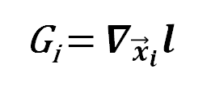
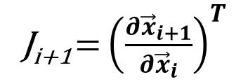
Reformulate BP as a Scan Operation
G_{i} = $∇_{{\vec{x}}_{i}}l$
J_{i+1} = ${\left(\frac{∂{\vec{x}}_{i+1}}{∂{\vec{x}}_{i}}\right)}^{T}$
Binary, associative operator:
+
A ◊ B = BA
Identity:
I
0
Input sequence:
G₇
1
J₇
2
J₆
3
J₅
4
J₄
5
J₃
6
J₂
7
J₁
8
Exclusive scan:
0
1
3
6
10
15
21
28
I
G₇
G₆
G₅
G₄
G₃
G₂
G₁
Key Insight: matrix multiplication in BP is also binary & associative!

Slide 14
Scale BP by Blelloch Scan
G₇
1
J₇
2
J₆
3
J₅
4
J₄
5
J₃
6
J₂
7
J₁
8
G₆
3
J_{5:6}
7
J_{3:4}
11
J_{1:2}
15
G₄
10
J_{1:4}
26
Logarithmic steps along the critical path!
2logn
G₄
10
I
0
Time
G₆
3
I
0
J_{3:4}
11
G₄
10
Down-sweep
A
B
G₇
1
I
0
J₆
3
G₆
3
J₄
5
G₄
10
J₂
7
G₂
Matrix multiplications are noncommutative.
21
B
AB
BA
I
0
G₇
1
G₆
3
G₅
6
G₄
10
G₃
15
G₂
21
G₁
28

Slide 15
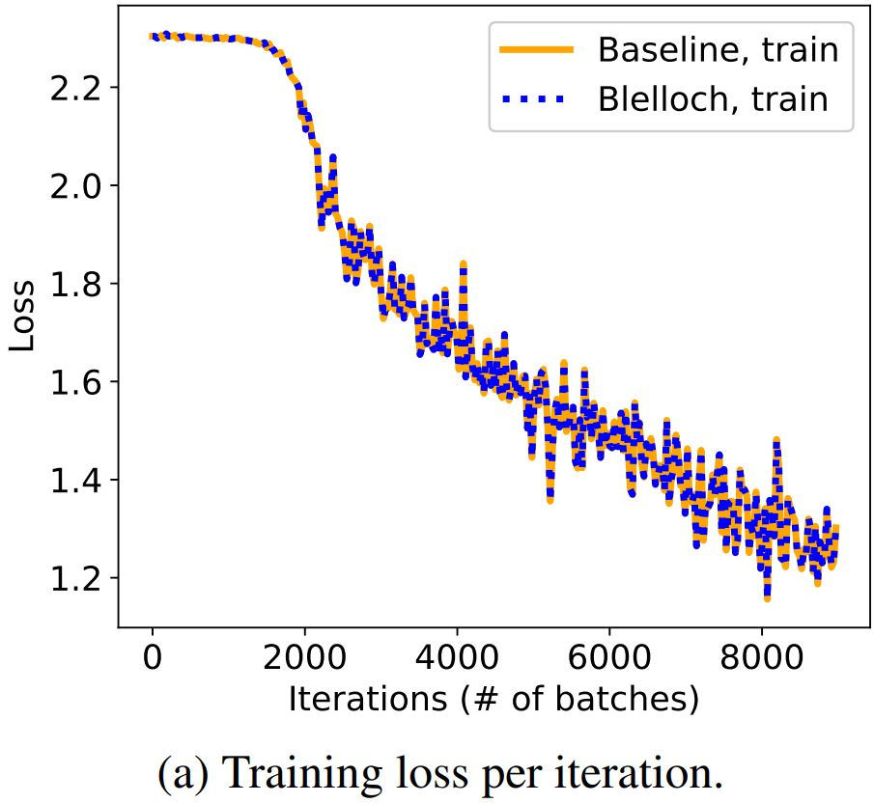
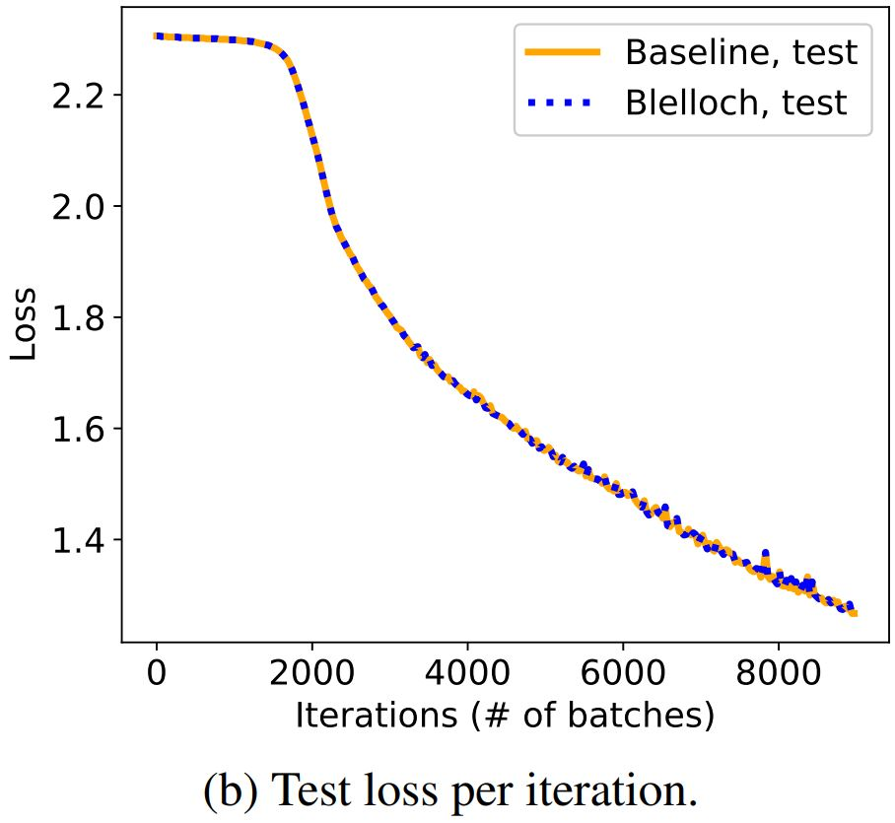
Reconstructs the Original BP Exactly
Our method produces gradients mathematically equivalent to BP.
The Jacobians are multiplied in a different order → numerical differences.
Empirically show that such differences do not effect convergence.
Training LeNet-5 on CIFAR-10 (baseline: PyTorch Autograd)

Slide 16











Jacobians are Memory & Compute Hungry
A full Jacobian can be prohibitively expensive to handle.
e.g., 1st convolution in VGG-11 on CIFAR-10 images occupy 768 MB of memory.
Generated one row at a time by passing basis vectors into Op_Grad() (the VJP function).
Conventional ML algorithms avoid using Jacobians directly (including BP).
$$Conv2d_Grad(\left[\begin{matrix}1 \\ 0 \\ 0 \\ \begin{aligned}0 \\ 0 \\ 0 \\ 0\end{aligned}\end{matrix}\right])$$
$$\vec{x}$$
ML Algo.
$$Conv2d_Grad(\left[\begin{matrix}0 \\ 0 \\ 1 \\ \begin{aligned}0 \\ 0 \\ 0 \\ 0\end{aligned}\end{matrix}\right])$$
3072
$$Conv2d_Grad(\left[\begin{matrix}0 \\ 1 \\ 0 \\ \begin{aligned}0 \\ 0 \\ 0 \\ 0\end{aligned}\end{matrix}\right])$$
$$Conv2d_Grad(\left[\begin{matrix}0 \\ 0 \\ 0 \\ \begin{aligned}0 \\ 1 \\ 0 \\ 0\end{aligned}\end{matrix}\right])$$
$$Conv2d_Grad(\left[\begin{matrix}0 \\ 0 \\ 0 \\ \begin{aligned}1 \\ 0 \\ 0 \\ 0\end{aligned}\end{matrix}\right])$$
$$Conv2d_Grad(\left[\begin{matrix}0 \\ 0 \\ 0 \\ \begin{aligned}0 \\ 0 \\ 0 \\ 1\end{aligned}\end{matrix}\right])$$
$$Conv2d_Grad(\left[\begin{matrix}0 \\ 0 \\ 0 \\ \begin{aligned}0 \\ 0 \\ 1 \\ 0\end{aligned}\end{matrix}\right])$$
65536
768 MB
$$\frac{∂f(\vec{x})}{∂\vec{x}}$$
$$f\left(\vec{x}\right)$$
Jacobians

Slide 17

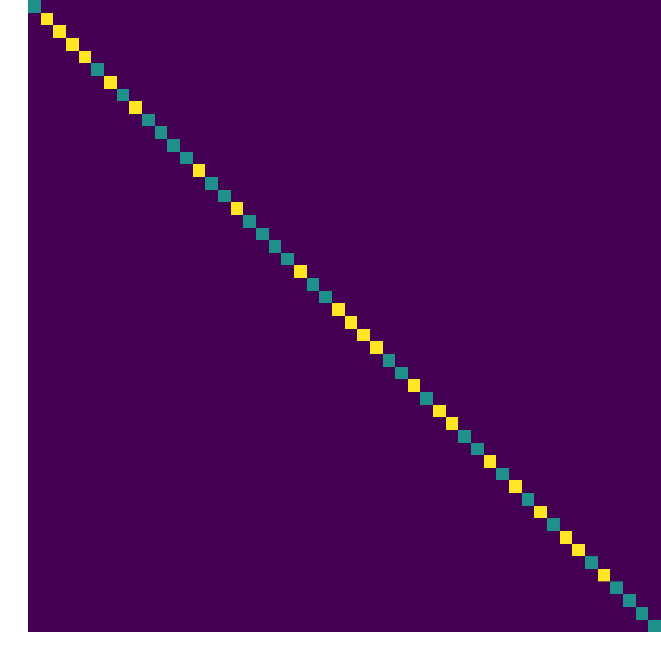
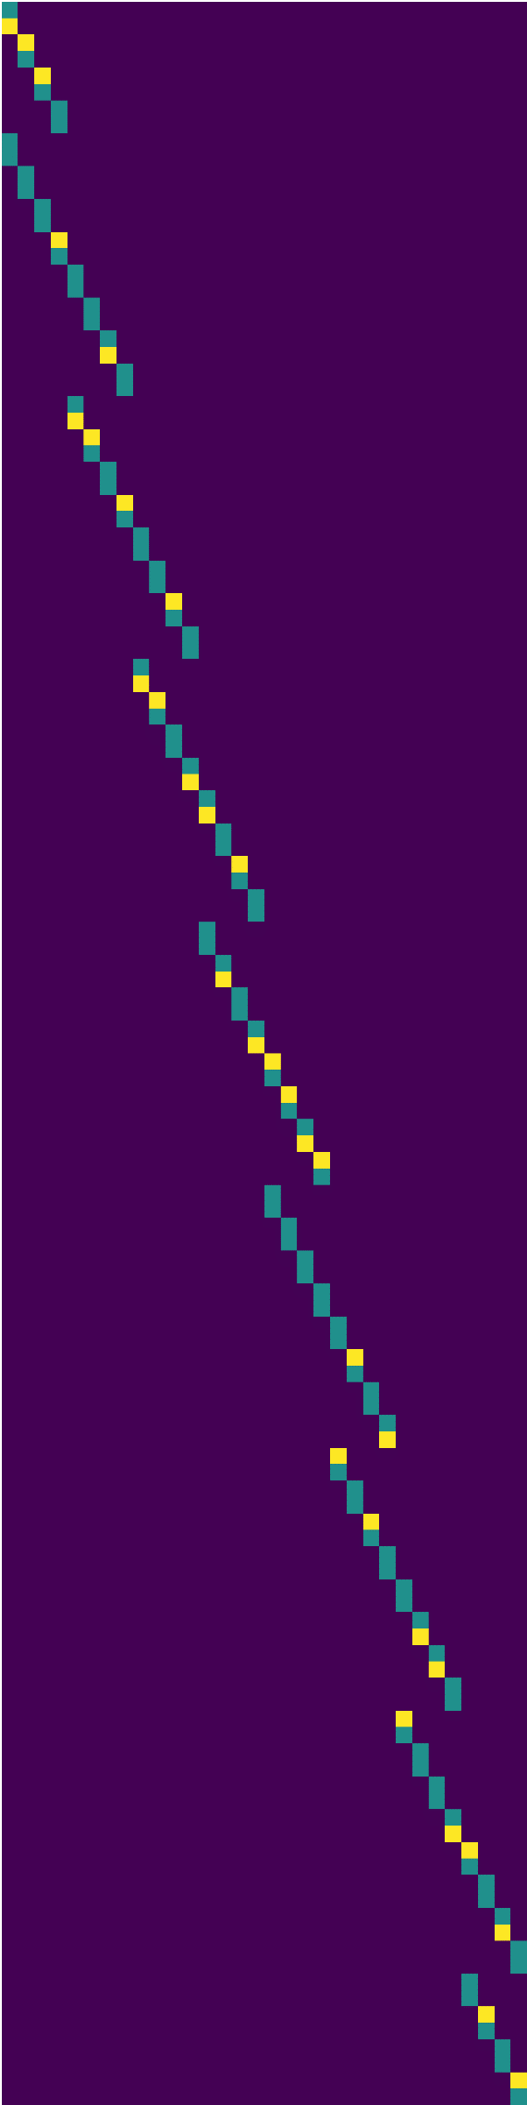
The Jacobians of Many Operators are Sparse
Non-zeros
Possible Zeros
Guaranteed Zeros
Guaranteed zeros:
Known ahead of training time.
Deterministic pattern.
Potentially better SpGEMM performance.
Conv2d
ReLU
MaxPool2D
First three ops of VGG-11 on CIFAR-10 | Convolution | ReLU | Max Pooling
Sparsity | 0.99157 | 0.99998 | 0.99994

Slide 18
Fast Sparse Jacobians Generation
Therefore, instead of calculating the Jacobians row-wise,
generate directly into Compressed Sparse Row (CSR):
data
0
0
0
0
0
0
Conv2d, W
1
2
0
3
indices
0
0
0
0
0
0
0
1
2
2
4
indptr
First three ops of VGG-11 on CIFAR-10 | Convolution | ReLU | Max Pooling
Jacobian Calculation Speedup | 8.3×10³ x | 1.2×10⁶ x | 1.5×10⁵ x

Slide 19
Complexity Analysis
Runtime:
Per-step Complexity (C): runtime of each step.
BPPSA
BP
C_{BPPSA}
Θ(log n)
vs.
C_{BP} Θ(n)
Performance benefits:
Large n: deep network, long sequential dependency.
Reducing per-step complexity: SpGEMM.
In-place
Up-sweep
Down-sweep
A
B
A
B
Constant per-device space complexity!
BA
B
AB

Slide 20
Methodology: Benchmark
Model: RNN
Task: Bitstream Classification
$${\vec{h}}_{t}^{\left(k\right)}=\tanh\left(W_{ih}x_{t}^{\left(k\right)}+{\vec{b}}_{ih}+W_{hh}{\vec{h}}_{t−1}^{\left(k\right)}+{\vec{b}}_{hh}\right)$$
C=4
V100
0
1
0
0
1
0
0
1
1
0
$$x_{t}^{\left(k\right)}{\sim Bernoulli(0.05+C}^{\left(k\right)}×0.1)$$

Slide 21

Methodology: Environment
Hardware:
RTX 2070
RTX 2080 Ti
Baseline:
7.5.1
7.6.2
1.1
1.2
Implementation: custom CUDA 10 kernels.

Slide 22
End-to-end Training Speedup
Training curve of BPPSA v.s. the baseline
when batch size B=16, sequence length T=1000:
Numerical differences do not effect convergence.
2.17× speedup on the overall training time.

Slide 23
Sensitivity Analysis: Model Length
Sequence length (T) reflects the model length n.
108× =
BPPSA scales with the model length (n);
until being bounded by the number of workers (p).

Slide 24
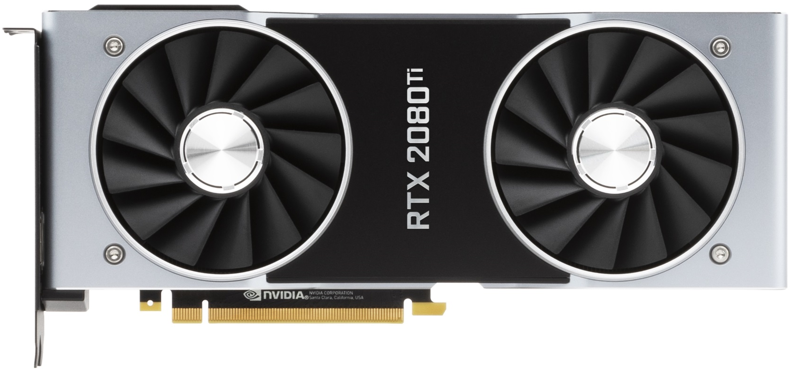
Sensitivity Analysis: Number of Workers
Fraction of GPU per sample (1/B) reflects the number of workers p.
BPPSA scales with the number of workers (p).

Slide 25
Sensitivity Analysis: 2070 v.s. 2080Ti
#SMs(2070) < #SMs(2080Ti)
→ Latency(2070) > Latency(2080Ti)
SM: Streaming Multiprocessor; i.e., “Parallel Cores”.

Slide 26
More Results in the Paper
End-to-end benchmarks of GRU training on IRMAS.
  A more realistic version of the RNN results.
Pruned VGG-11 retraining on CIFAR-10.
  Microbenchmark via FLOP measurements.
  Evaluate the effectiveness of leveraging the Jacobians’ sparsity in CNNs.

Slide 27
Conclusion
BP imposes a strong sequential dependency among layers during the gradient computations, limiting its scalability on parallel systems.
We propose scaling Back-Propagation by Parallel Scan Algorithm (BPPSA):
Reformulate BP as a scan operation.
Scale by a customized Blelloch scan algorithm.
Leverage sparsity in the Jacobians.
Key Results: Θ(log n) vs. Θ(n) steps on parallel systems.
Up to 108× speedup on the backward pass (→ 2.17× overall speedup).

